Slide 1

Rider Behaviors and Membership Growth
Cyclistic
Case Study
Presented By: Shannon Johnson
Last Updated: July 2024

Slide 2
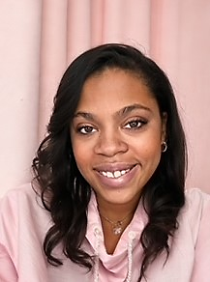
Hello!
My Name is Shannon Johnson
Github: github.com/Data4Enthusiast
Linkedin: linkedin.com/in/sjanalyst
Email: Shannon.Johnson.Analyst@gmail.com
B.Sc in BAIS
Aspiring Data Analyst

Slide 3
About Cyclistic
Company Development and Operations
Cyclistic launched a bikeshare program in 2016.
Operates 5,824 bicycles that are geotracked in a network of 692 stations throughout Chicago, IL.
Riders have the flexibility to unlock and return bikes at any station within the network.
There are three types of bikes- reclining bikes, hand tricycles, and cargo bikes.
Marketing Strategy and Financial Focus
Cyclistic marketing strategy is based on building awareness of the brand and appealing to broad consumer segments.
Finance analysts concluded that annual members are much more profitable than casual riders.
Cyclistic offers flexibility of its pricing plans: single-ride passes, full-day passes, and annual memberships.
Customer Types
Customers who purchase single-ride or full-day passes are referred to as casual riders.
Customers who purchase annual memberships are Cyclistic members.
Growth Strategy
The focus is to maximize current users for future growth.
Design marketing strategies aimed at converting casual riders into annual members.

Slide 4
Business Objective Derive actionable insights that will inform the development of targeted marketing strategies aimed at converting casual riders into annual members.
How do annual members and casual riders use Cyclistic bikes differently?

Slide 5


The Data
Conducted analysis using Divvy and the City of Chicago and made available via Data License Agreement
Consists of previous 12 months of data, from 01/2021 to 12/2021
Approximately 5.6 million data points
Was conducted on a 1st party basis indicating high integrity

Slide 6


“Casual” refers to any riders that were not Annual Members.
Due to Consumer Protection Laws, we can’t see how many times customers made a purchase.
We don’t have access to distance rode per trip.
Some null and general errors were present within the overall data.
DATA SHORTCOMINGS

Slide 7
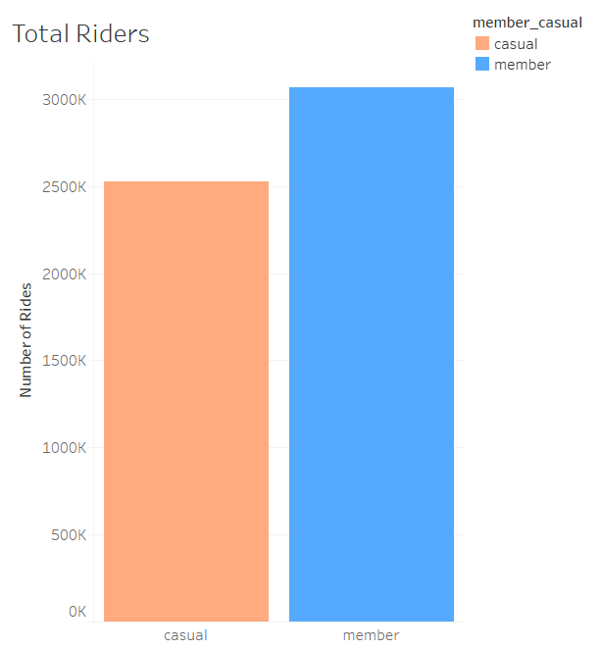
Key Findings: Total Trips by Customer Type
Annual Members utilized the bikeshare network the most at 55% of total trips.
Casual riders accounted for the remaining 45%.

Slide 8
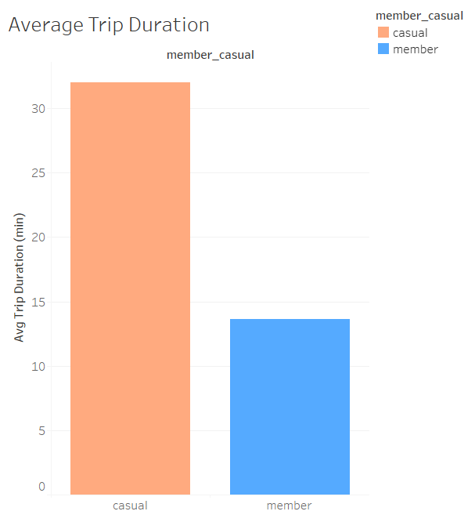
Key Findings: Average Trip Duration
Annual Members showed an average trip duration of just 13 minutes.
In comparison, Casual riders reported an average of 32 minutes for trip duration.
On average, Casual riders trip duration is 2.5 times longer than Annual Members.

Slide 9
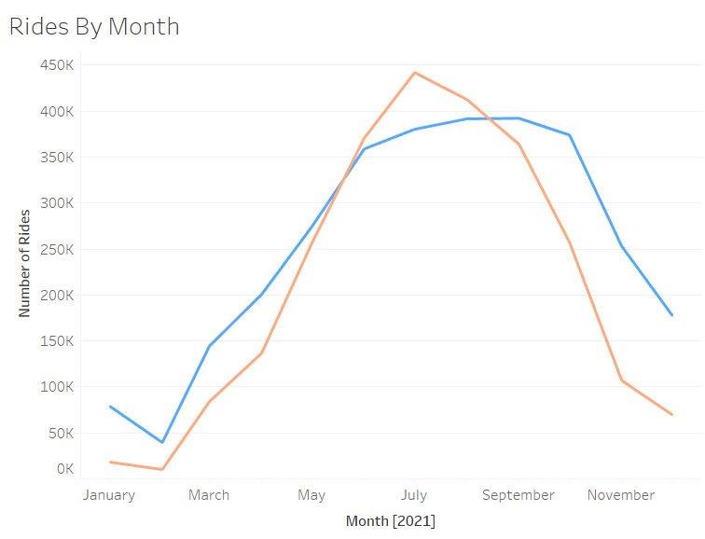
Key Findings: Rides by Month
The peak activity for all riders are within the summer, making it the busiest time of year.
Annual Members showed a peak of activity from June through October.
Casual riders reported an increase of activity during June through September.

Slide 10
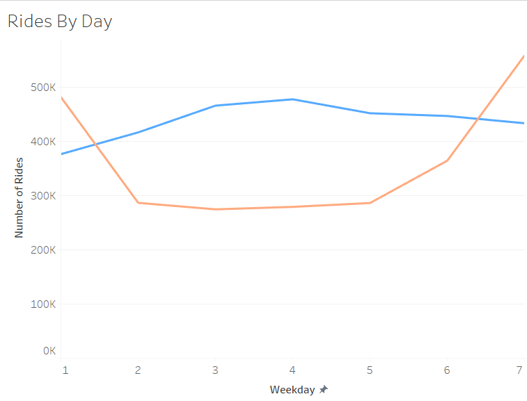
Key Findings: Rides by Day
Annual Members are most active on Wednesdays.
Casual riders reported the peak day of the week to be on Saturday.

Slide 11
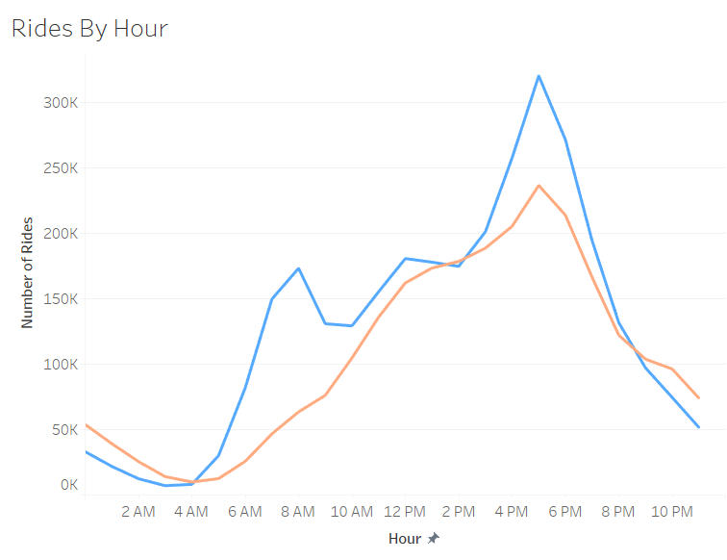
Key Findings: Rides by Hour
The peak hours for all riders occurs after lunch time and peaks at 5pm.
The peak hours for Annual Members are 5pm and 8am, marking these times as rush hour.
Casual riders has a peak hour of 5pm.

Slide 12
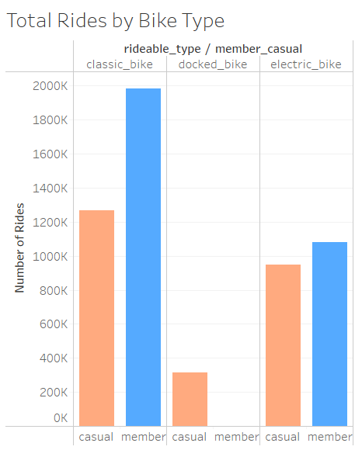
Key Findings: Most Utilized Bike Types
The most utilized bike type for both Casual and Annual Members was the Classic bike.
65% of Annual Member preferred the Classic bike, 34.99% preferred the Electric bike, and only 1 member used the docked bike.
50% of Casual riders preferred the Classic bike, 37.6% utilized Electric bikes, and the remaining 12.4% used the Docked bikes.
Docked bikes were least preferred with all riders.

Slide 13



Summary
Casual Riders
Casual riders predominantly used the bikeshare network during the summer months of June to August, with usage peaking in July.
On average, Casual riders recorded longer trip durations compared to Annual Members.
The highest usage days for Casual riders were Saturday and Sunday.
Annual Members
Annual Members showed a preference for using the bikeshare network from June to October, with a peak in September.
The most utilized days of the week for Annual Members were Tuesday and Wednesday.
Both Riders
Both Annual Members and Casual riders preferred Classic and Electric bikes over docked bikes.
The overall peak usage hour for all riders is 5 PM.

Slide 14

Recommendations
Implement rewards programs aimed at converting Casual riders to Annual Members, offering enhanced benefits for membership.
Introduce seasonal plans tailored for peak summer months, with promotional efforts beginning in the winter to drive awareness.
Develop additional Annual Membership options targeting summer riders, with special benefits for usage on slower days such as Tuesdays.
Conduct unbiased surveys targeting both current users and non-users of Cyclistic to gain deeper insights into their motivations and perceptions of bikeshare programs.
Collect and analyze demographic data to better understand the profiles of Cyclistic's users and optimize marketing strategies accordingly.

Slide 15




Thank you
Shannon Johnson
Shannon.Johnson.Analyst@gmails.com

